Slide 1


PLEDGE TO PROGRESS Sustainability Hackathon
Sponsored By
Your Team Name : Kshitiz
Your team bio : One member team ☺
Date : 24 April 2023

Slide 2
Problem Statement?
Public spaces like religious shrines, big music concerts, tourist destinations, bridges etc. which are meant for mass gatherings or usage sometimes lack a regulatory mechanism to control the number of people utilizing them simultaneously. Unfortunate circumstances can cause stampedes in public spaces or breakage of manmade structures due to overload. These kinds of events could have been managed to some extent if there was any kind of auto-control mechanism to restrict the number of people entering when it is more than what the place or structure can sustain. Also, the mechanism must be a cost-effective and easily maintained solution for its better acceptance.

Slide 3
User Segment & Pain Points
This kind of regulatory mechanism can help the government or local authorities to manage the usage of public spaces and ensure public safety and longevity of the construction.
Private event management companies can also utilize this tool to manage event attendees count.
It is not possible to predict the inflow every time. So, an automated regulatory mechanism is necessary to monitor the count. And if the count is more than the limit, authorities must be intimated to take necessary action. This alert can also be made visible to the newcomers so that they can become cautious and wait till the place is less crowded.

Slide 4
Pre-Requisite
Generally, people counting is either not performed or managed by counting manually in most places. Auto-counting is only done at hi-tech places like malls and offices. The idea is to extend this facility to all the places where the inflow of people is not very predictable.
The primary input required for this tool to work is the live feed from the venue’s CCTV. Other than that a computing machine with network availability is the only requirement.

Slide 5
Tools or resources
Azure Machine Learning – to develop the model
Azure Cloud Services – to manage, update and distribute the tool when required.

Slide 6
Any Supporting Functional Documents
The technology of Computer Vision could be useful to find a potential solution to this problem. Nowadays most public spaces are under surveillance by CCTV cameras for security purposes and they are often connected to a computer for storing and monitoring. This tool can run on these computers (with some upgrades, if necessary) and track the people’s counts using the live feed from the CCTV cameras. A central hub then takes input from all exits/entries and calculates the final count.
Experts can decide on a threshold safety limit for the respective place. The limit is the maximum number of people the venue can sustain without damaging the structure. It is also determined based on its available exit facilities which can allow them to leave safely in case of any emergency.
In case when the computing machinery is not up to the mark, then the tool can be run on the cloud.

Slide 7
Key Differentiators & Adoption Plan
The main thought behind making this tool is that it should work with the limited technical resources available in these kinds of places.
Limited data input:
It works with just the live video feed from the CCTV cameras, generally installed at the entrance and exits.
Limited infrastructure:
The tool can be installed on the PC connected to these cameras, with one PC consolidating the total count
Cost-effective:
It can work with the existing infrastructure with a slight upgrade
Easy to implement

Slide 8
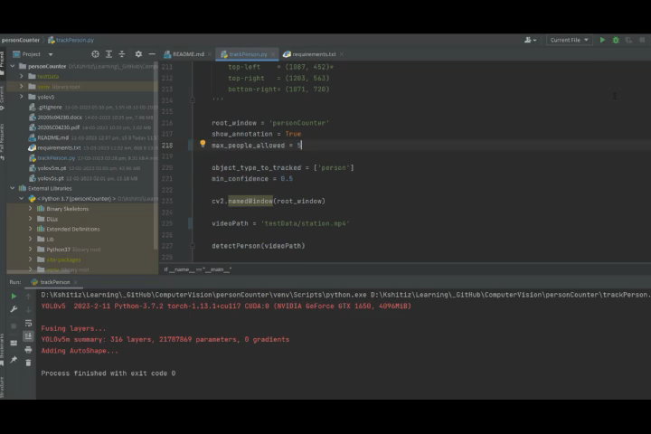
GitHub Repository Link & supporting diagrams, screenshots, if any
GitHub repository: https://github.com/kshitizkumarjangir/personCounter
Sample output:

Slide 9
Thank You
Kshitiz Kumar
An application like this alone does not guarantee safety, however, it can play a major role in ensuring it.

